Slide 1
Inženjerstvo softvera za Internet-Web of Things
Komunikacija

Slide 2
Uvod
Ključni delovi IoT tehnologije su:
Senzori
Aktuatori
Komunikacija
Komunikacija je omogućena upotrebom velikog broja tehnologija:
Bluetooth
WiFi
NFC (Near Field Communication)
RFID (Radio Frequency Identification)
Zigbee
LoRa (Long Range)
Ethernet,...

Slide 3
Protokoli
Obradićemo
TCP/IP protokol
WiFi
Ethernet
Bluetooth Low Energy (BLE)

Slide 4
TCP/IP

Slide 5
Osnovne odrednice TCP/IP protokola
Osnova je IP mrežni protokol
Pojam socket-a: par (IP adresa, port)
Mogućnost korišćenja TCP i UDP protokola
Razlika

Slide 6

Socket _{1/2}
Par (IP adresa, port)
Uspostavljena veza između dva programa određena je parom socket-a

Slide 7
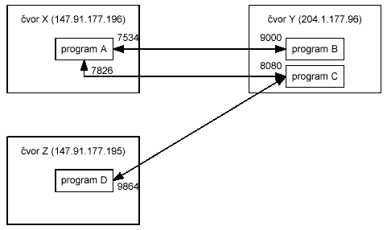
Socket _{2/2}
Više programa u vezi

Slide 8
Identifikacija čvorova mreže
Pomoću simboličke adrese, npr. www.yahoo.com
DNS
Pomoću numeričke adrese, podeljene u oktete, npr. 147.91.177.196
IPv4 vs. IPV6

Slide 9
TCP/IP server u Pajtonu
s = socket.socket() # Create a socket object
print ('Waiting for connections on host: ' + host)
s.bind((host, port)) # Bind to the port
s.listen(5) # Now wait for client connection.
while True:
c, addr = s.accept() # Establish connection with client.
print ('Got connection from ', addr)
threading.Thread(target=threadsock, args=[c]).start()

Slide 10
TCP/IP server u Pajtonu
def threadsock(c):
# kada se neko spoji na nas program preko socketa
# procitamo maks 1KB od klijenta
text = c.recv(1024)
if text == b'':
return
print (text)
# pristupicemo globalnoj promenljivoj counter da bismo je menjali
global counter
counter = counter + 1
text = 'counter: ' + str(counter) + '\n'
c.send(text.encode())
c.close()

Slide 11
TCP/IP klijent u Pajtonu
client_socket = socket.socket() # instantiate
print ('Connecting to: ' + host)
client_socket.connect((host, port)) # connect to the server
message = input(" -> ") # take input
client_socket.send(message.encode()) # send message
data = client_socket.recv(1024).decode() # receive response
print('Received from server: ' + data) # show in terminal
client_socket.close() # close the connection

Slide 12
REST klijent u Pajtonu
Koristimo, recimo, Requests biblioteku
import requests
requests.get(STATUS_HOST)
requests.get(STATUS_HOST, timeout=0.1)

Slide 13
TCP/IP komunikacija na Arduino/ESP32
Nema operativnog sistema
Koriste se biblioteke
Biblioteke za WiFi i za Ethernet
Podrška za WiFi je ugrađena u postojeće biblioteke
Podrška za Ethernet zavisi od hardvera i mora da se instalira

Slide 14
TCP/IP server preko WiFi na ESP32
void handleRoot() {
server.send(200, "text/plain", "hello from esp8266!");
}
void handleNotFound() {
server.send(404, "text/plain", "not found");
}
void setup(void) {
WiFi.begin(ssid, password);
while (WiFi.status() != WL_CONNECTED) { delay(500); }
server.on("/", handleRoot);
server.on("/inline", []() {
server.send(200, "text/plain", "this works as well");
});
server.onNotFound(handleNotFound);
server.begin();
}
void loop(void) {
server.handleClient();
}
const char* ssid = "........";
const char* password = "........";
WebServer server(80);

Slide 15
TCP/IP klijent preko WiFi na ESP32
void setup(void) {
WiFi.begin(ssid, password);
while (WiFi.status() != WL_CONNECTED) { // Wait for connection
delay(500);
}
HTTPClient http;
http.begin("http://neki.server.com/putanja");
int httpCode = http.GET();
if(httpCode > 0) {
if(httpCode == HTTP_CODE_OK) {
String payload = http.getString();
}
}
http.end()
}

Slide 16
Skeniranje WiFi
void setup() {
Serial.begin(115200);
// Set WiFi to station mode and disconnect from an AP if it was previously connected
WiFi.mode(WIFI_STA);
WiFi.disconnect();
delay(100);
}
void loop() {
Serial.println("scan start");
// WiFi.scanNetworks will return the number of networks found
int n = WiFi.scanNetworks();
if (n > 0) {
for (int i = 0; i < n; ++i) {
Serial.printf("%s (%s) ", WiFi.SSID(i), WiFi.RSSI(i));
Serial.println((WiFi.encryptionType(i) == WIFI_AUTH_OPEN)?" ":"*");
delay(10);
}
}
delay(5000);
}

Slide 17
TCP/IP preko Etherneta na ESP32 i RPI Zero
Nema ugrađen Ethernet port
Mora da se nabavi
Jevtino Ethernet rešenje: ENC28J60 modul
za njegov rad je potreban SPI interfejs, a to svi navedeni uređaji poseduju (za RPI Zero W je samo potrebno da se uključi podrška za SPI u okviru raspi-config aplikacije)
Repozitorijumi:
Arduino: https://github.com/njh/EtherCard
https://github.com/UIPEthernet/UIPEthernet
RPI: https://mvidakovic.blogspot.com/2018/08/raspberry-pi-stuff.html#zeroeth

Slide 18
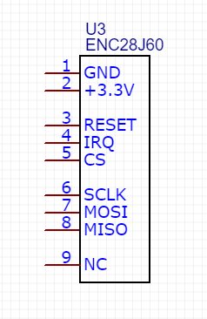
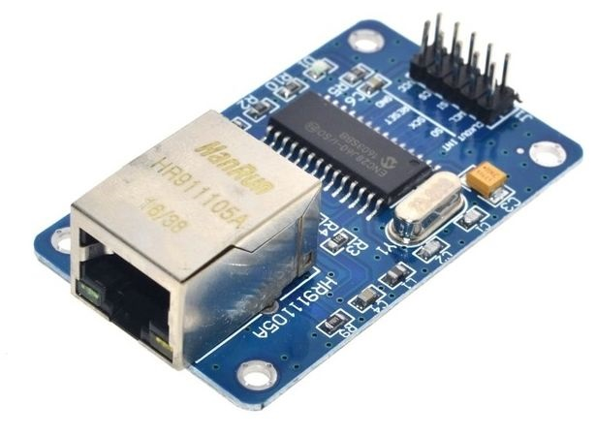
ENC28J60 modul

Slide 19
ENC28J60 na RPI
Pi PinNo ENC28J60
-----------------------------------
+3V3 17 VCC
GPIO10/MOSI 19 SI
GPIO9/MISO 21 SO
GPIO11/SCLK 23 SCK
GND 20 GND
GPIO25 22 INT
GPIO8/CE0 24 CS
Dodati u /boot/config.txt
dtoverlay=enc28j60

Slide 20
TCP/IP server na ENC28J60
EthernetServer server = EthernetServer(LISTENPORT);
void setup() {
uint8_t mac[6] = {MACADDRESS}; uint8_t myIP[4] = {MYIPADDR}; uint8_t myMASK[4] = {MYIPMASK};
uint8_t myDNS[4] = {MYDNS}; uint8_t myGW[4] = {MYGW};
Ethernet.begin(mac, myIP, myDNS, myGW, myMASK);
server.begin();
}
void loop() {
while(true) {
size_t size;
if (EthernetClient client = server.available()) {
while((size = client.available()) > 0) {
uint8_t* msg = (uint8_t*)malloc(size+1); memset(msg, 0, size+1);
size = client.read(msg,size);
printf(msg); // uradimo nešto sa primljenom porukom
free(msg);
}
client.stop();
}
}

Slide 21
TCP/IP klijent na ENC28J60
EthernetClient client;
void setup() {
uint8_t mac[6] = {MACADDRESS}; uint8_t myIP[4] = {MYIPADDR};
uint8_t myMASK[4] = {MYIPMASK}; uint8_t myDNS[4] = {MYDNS};
uint8_t myGW[4] = {MYGW};
Ethernet.begin(mac, myIP, myDNS, myGW, myMASK);
}
void loop() {
if (client.connect(server_addr, PORT)) {
client.printf("GET /level/%d/DEVICE%d HTTP/1.1\r\nHost: %s:5000\r\n\r\n", lightValue, DEVICE_ID, myIPAddress);
Serial.printf("Available bytes: %d\n", client.available());
client.flush();
usleep(100000); // 0.1 sec sleep
client.stop();
return;
}
}

Slide 22
Rad sa HTTPS na Arduino/ESP32 platformi
Nije automatski podržana
Nedovoljno resursa da se implementira provera HTTPS sertifikata preko CA (Certificate Authority)
Sertifikat mora da se ugradi u kod
Prvo se pokupi sa web sajta
Iskonvertuje se u niz bajtova
Ugradi u kod
Komplikovano, zar ne?

Slide 23
Bluetooth Low Energy

Slide 24
Bluetooth
Bežična komunikaciona tehnologija kratkog dometa
Opseg frekvencija: 2,402GHz do 2,48GHz
Osnovna namena je bila da zameni žične konekcije za razmenu datoteka između računara i mobilnih telefona, kao i da zameni žične slušalice
To se proširilo na:
Bežične slušalice, zvučnike i mikrofone
Bežične miševe i tastature
Bežične selfie stick-ove
Praćenje lokacije uređaja i objekata
Ostalo

Slide 25

Bluetoothe Low Energy (BLE)
Omogućava bežični prenos podataka između "low energy" uređaja (beacons) i ostalih uređaja
Ideja je da beacon periodično šalje Advertizing poruke, koje ostali uređaji (smartphones) mogu da primete i da se konektuju na beacone
Namena:
Pametni satovi (smart watches)
Bežični monitori zdravstvenih parametara
Fitness trackers
Bežične slušalice, mikrofoni, itd.
HID (Human Interface Device) devices (bežične tastature, miševi, itd.)
Ostalo

Slide 26
Osnove BLE
Radi na opsegu frekvencija od 2.400GHz do 2.4835 GHz
Koristi se Generic Attribute Profile (GATT):
Client – uređaj koji se spaja na beacon, na primer pametni telefon
Server – uređaj na koji se spajaju klijenti, na primer fitness tracker
Characteristic (karakteristika) – vrednost koja se prenosi od beacona do uređaja, na primer, napon na bateriji
Service (servis) – kolekcija karakteristika koje podržava beacon
Descriptor (opis) – dodatne informacije o karakteristici, na primer, jedinica mere (Volt)
Identifiers – karakteristike, servisi i opisi se identifikuju jedinistvenim identifikatorom - UUID

Slide 27
BLE na RPI
Modeli koji imaju WiFi, imaju i BLE
Postoje razne biblioteke koje se mogu koristiti za BLE
bleak: pip install bleak
Skeniranje BLE uređaja u blizini:
import asyncio
from bleak import BleakScanner
async def main():
devices = await BleakScanner.discover()
for d in devices:
print(d)
asyncio.run(main())

Slide 28
BLE advertisment data
devices = await BleakScanner.discover(
return_adv=True, cb=dict(use_bdaddr=args.macos_use_bdaddr)
)
for d, a in devices.values():
print(d)
print(a)

Slide 29
Prijem notifikacija sa BLE uređaja
def match_nus_uuid(device: BLEDevice, adv: AdvertisementData):
print(adv.local_name)
if adv.local_name == 'ESP32 UART Test':
return True
return False
device = await BleakScanner.find_device_by_filter(match_nus_uuid)
def handle_rx(_: BleakGATTCharacteristic, data: bytearray):
print("received:", data)
async with BleakClient(device, disconnected_callback=handle_disconnect) as client:
await client.start_notify(UART_TX_CHAR_UUID, handle_rx)

Slide 30
Slanje podataka od RPI na BLE uređaj
nus = client.services.get_service(UART_SERVICE_UUID)
rx_char = nus.get_characteristic(UART_RX_CHAR_UUID)
s = "sadfasdf"
client.write_gatt_char(rx_char, s)

Slide 31
BLE uređaj na ESP32
ESP32 može da radi kao BLE uređaj
Inicijalizacija:
#define SERVICE_UUID "6E400001-B5A3-F393-E0A9-E50E24DCCA9E" // Nordic UART Service UUID
#define CHARACTERISTIC_UUID_RX "6E400002-B5A3-F393-E0A9-E50E24DCCA9E"
#define CHARACTERISTIC_UUID_TX "6E400003-B5A3-F393-E0A9-E50E24DCCA9E"
// Create the BLE Device
BLEDevice::init("ESP32 UART Test"); // Give it a name
// Create the BLE Server
BLEServer *pServer = BLEDevice::createServer();
pServer->setCallbacks(new MyServerCallbacks());
// Create the BLE Service
BLEService *pService = pServer->createService(SERVICE_UUID);
// Create a BLE Characteristic
pCharacteristic = pService->createCharacteristic(
CHARACTERISTIC_UUID_TX,
BLECharacteristic::PROPERTY_NOTIFY
);
pCharacteristic->addDescriptor(new BLE2902()); // Karakteristika za notifikacije mora da ima deskriptor (0x2902)
Client Characteristic Configuration

Slide 32
Callback kada se neko spoji na ESP32
class MyServerCallbacks: public BLEServerCallbacks {
void onConnect(BLEServer* pServer) {
deviceConnected = true;
digitalWrite(LED, HIGH);
#ifdef DEBUG
Serial.println("Device connected");
#endif
};
void onDisconnect(BLEServer* pServer) {
deviceConnected = false;
digitalWrite(LED, LOW);
#ifdef DEBUG
Serial.println("Device disconnected");
#endif
ESP.restart(); // ponekad upadne u čudno stanje nakon raskida BLE veze, pa ga restartujemo
}
};

Slide 33
Nastavak inicijalizacije – registracija prijema poruka od uređaja
BLECharacteristic *pCharacteristic2 = pService->createCharacteristic(
CHARACTERISTIC_UUID_RX,
BLECharacteristic::PROPERTY_WRITE
);
pCharacteristic2->setCallbacks(new MyCallbacks());
// Start the service
pService->start();
// Start advertising
pServer->getAdvertising()->start();
#ifdef DEBUG
Serial.println("Waiting a client connection to notify...");
#endif

Slide 34
Callback za prijem poruka od uređaja
class MyCallbacks: public BLECharacteristicCallbacks {
void onWrite(BLECharacteristic *pCharacteristic) {
std::string rxValue = pCharacteristic->getValue();
if (rxValue.length() > 0) {
Serial.print("Received Value: ");
for (int i = 0; i < rxValue.length(); i++) {
Serial.print(rxValue[i]);
}
// Do stuff based on the command received from the app
if (rxValue.find("A") != -1) {
Serial.print("Turning ON!");
digitalWrite(LED, HIGH);
}
else if (rxValue.find("B") != -1) {
Serial.print("Turning OFF!");
digitalWrite(LED, LOW);
}
}
}
};

